Slide 1
CS 4504 Parallel and Distributed Computation Distributed Lock
Kun Suo
Computer Science, Kennesaw State University
https://kevinsuo.github.io/

Slide 2
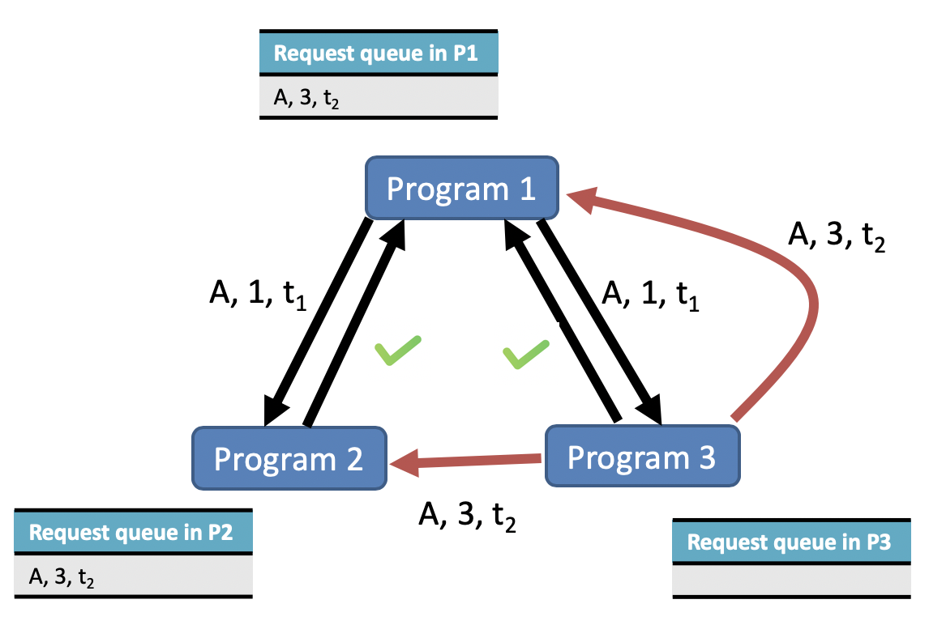
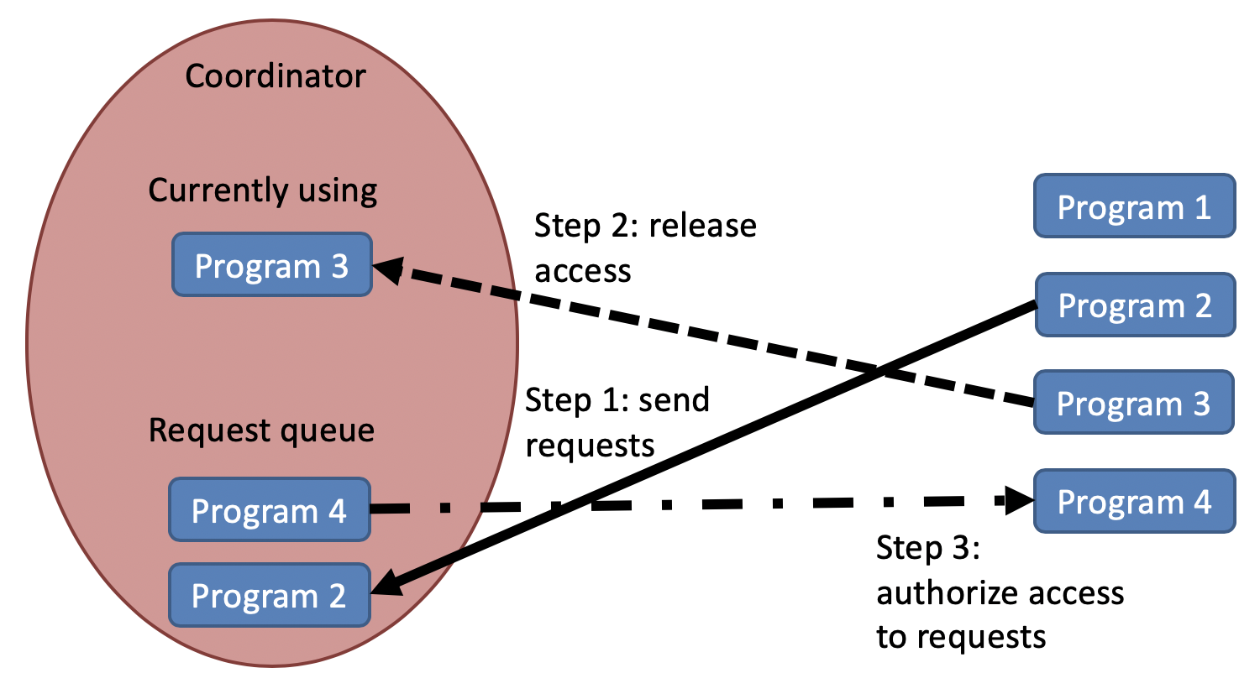
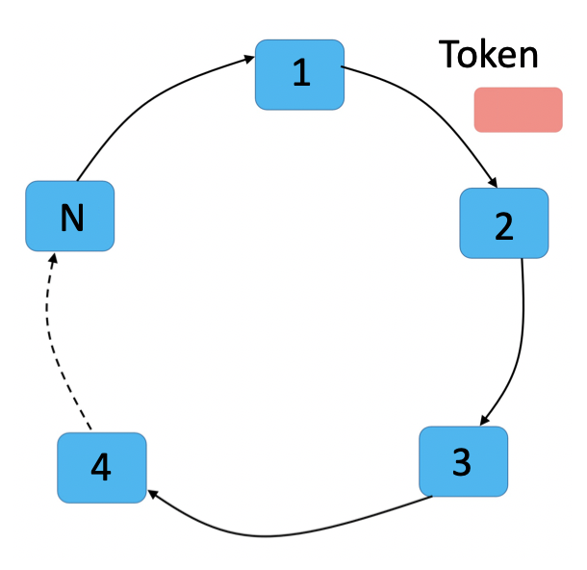
Revisit Distributed Mutex
In a distributed system, the method to achieve access to exclusive resource is called Distributed Mutual Exclusion
Distributed algorithm
Centralized algorithm
Token Ring Algorithm

Slide 3
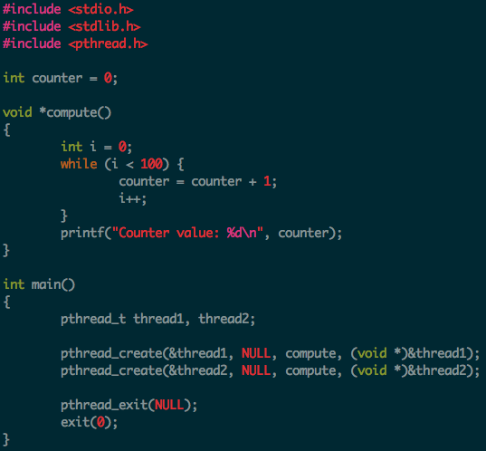

Race condition
https://github.com/kevinsuo/CS3502/blob/master/race_condition.c
A race condition occurs when two or more threads access shared data and they try to change it at the same time.
The order in which the threads attempt to access the shared data makes the results unpredictable
Race condition occurs for variable counter
Seem nothing wrong?

Slide 4
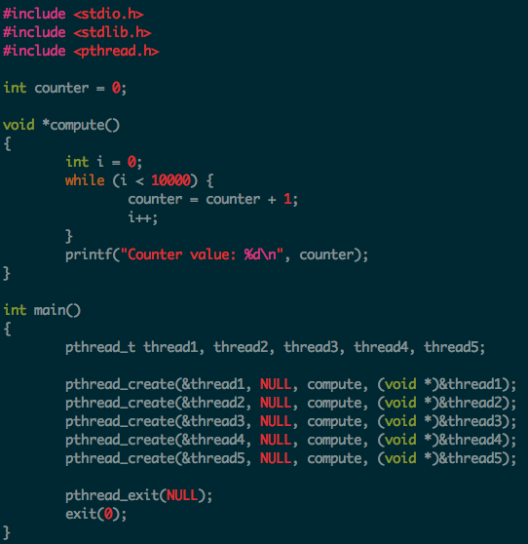
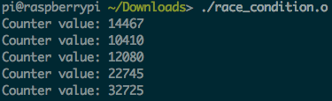
Race condition example
Increase the loop number
Add more threads
Weird results!

Slide 5
Critical section
A section of code in a concurrent task that modifies or accesses a resource shared with another task.
Examples
A piece of code that reads from or writes to a shared memory region
Or a code that modifies or traverses a shared linked list.

Slide 6
Critical section example
Critical section: All threads read and write the shared counter

Slide 7
Lock (mutual exclusion)
A lock (mutual exclusion) is a synchronization mechanism for enforcing limits on access to a resource in an environment where there are many threads of execution
Types of mutual mechanism:
Busy-waiting, e.g., spinlock
Sleep and wakeup
Hold
Release
Hold
Release
A
A
Wakeup and Get lock
Get lock
fail and sleep
B
B

Slide 8
Deadlocks
When two or more processes stop making progress indefinitely because they are all waiting for each other to do something.
If process A waits for process B to release a resource, and
Process B is waiting for process A to release another resource at the same time.
In this case, neither A not B can proceed because both are waiting for the other to proceed.
R1
Process A
Process B
R2

Slide 9
Deadlock example
R1
Process A
Process B
R2
Thread 1
Thread 2
pthread_mutex_lock(&m1);
/* use resource 1 */ pthread_mutex_lock(&m2);
/* use resources 1 and 2 */
do_something();
pthread_mutex_unlock(&m2); pthread_mutex_unlock(&m1);
Stuck right here
pthread_mutex_lock(&m2);
/* use resource 2 */ pthread_mutex_lock(&m1);
/* use resources 1 and 2 */
do_something();
pthread_mutex_unlock(&m1); pthread_mutex_unlock(&m2);

Slide 10
What is a distributed lock?
Distributed lock refers to a type of lock in which the system is deployed on multiple machines to achieve mutual exclusion between multiple processes in distributed system.
In order to ensure that multiple processes can see the lock, such the lock is stored in the public storage (such as Redis, Memcache, database and other three-party storage), so that multiple processes can concurrently access the same critical resource, and only one process can access the shared resource at the same time.

Slide 11
Example
Our online store sells two diamonds
5 users (A, B, C, D, E) order at the same time
If you design the online system, who will get the diamond?

Slide 12
Example
Different e-commerce companies adopt different strategies:
Some e-commerce companies determine who can make a successful purchase based on the order time, First-come-first-serve
Some e-commerce companies determine who can make a successful purchase based on the payment time
…
No matter which policy, the online store must make sure every diamond cannot be sold to two users

Slide 13
Example
Different e-commerce companies adopt different strategies:
Some e-commerce companies determine who can make a successful purchase based on the order time, First-come-first-serve
Some e-commerce companies determine who can make a successful purchase based on the payment time
…
No matter which policy, the online store must make sure every diamond cannot be sold to two users. In large-scale distributed systems, we use distributed locks to realize that.

Slide 14
Distributed Locks
3 ways to implement distributed locks:
Distributed locks based on databases, here databases refer to relational databases;
Distributed locks based on caches;
Distributed locks based on ZooKeeper.

Slide 15
Some Key Questions for Distributed Locks
Mutual exclusion:
A distributed lock should be able to guarantee that a resource or a method can only be operated by one process of one machine at a time.
Preventing deadlock:
Even if one process does not actively unlock due to crash while holding the lock, it can guarantee that other processes can obtain the lock.
Reentrancy:
A critical resource can be accessed multiple times when the process has not released the lock.
Performance:
Have a high availability for lock acquisition and release.

Slide 16
1. Distributed locks based on databases
The easiest way is to create a lock table, and then manipulate the data in the table to achieve distributed locks
Lock a resource → add a record to this table; Release the lock → delete this record.
The database has consistent constraint on shared resources. If multiple requests are submitted to the database at the same time, the database will ensure that only one operation will be successful, and the thread that successfully operates will obtain a lock.
Table

Slide 17
1. Distributed locks based on databases
Problem for database:
The database needs to read/write the hard disk. Frequent interaction with the database will cause large I/O overhead
Only suitable for scenarios with low concurrency and low performance requirements

Slide 18
1. Distributed locks based on databases
Example:
Our online store sells 2 diamonds
5 users (A, B, C, D, E) order at the same time
A orders 1 diamond, B orders 2 diamonds, C orders 1 diamond
Suppose A and B order the same time, and A request arrives first
A
item | user | number
B
C
Diamond: 2

Slide 19
1. Distributed locks based on databases
Example:
Our online store sells 2 diamonds
5 users (A, B, C, D, E) order at the same time
A orders 1 diamond, B orders 2 diamonds, C orders 1 diamond
Added a record about user A to the database
A
item | user | number
001 | A | 1
B
C
Diamond: 1
2->1

Slide 20
1. Distributed locks based on databases
Example:
Our online store sells 2 diamonds
5 users (A, B, C, D, E) order at the same time
A orders 1 diamond, B orders 2 diamonds, C orders 1 diamond
A
Reply yes
Delete A’s record in database
item | user | number
B
C
Diamond: 1

Slide 21
1. Distributed locks based on databases
Example:
Our online store sells 2 diamonds
5 users (A, B, C, D, E) order at the same time
A orders 1 diamond, B orders 2 diamonds, C orders 1 diamond
When B request comes
A
Write B’s record into database
item | user | number
002 | B | 2
B
C
Diamond: 1

Slide 22
1. Distributed locks based on databases
Example:
Our online store sells 2 diamonds
5 users (A, B, C, D, E) order at the same time
A orders 1 diamond, B orders 2 diamonds, C orders 1 diamond
A
Reply no
Delete B’s record in database
item | user | number
B
C
Diamond: 1

Slide 23
1. Distributed locks based on databases
Example:
Our online store sells 2 diamonds
5 users (A, B, C, D, E) order at the same time
A orders 1 diamond, B orders 2 diamonds, C orders 1 diamond
When C request comes
A
Write C’s record into database
item | user | number
003 | C | 1
B
C
Diamond: 0

Slide 24
1. Distributed locks based on databases
Example:
Our online store sells 2 diamonds
5 users (A, B, C, D, E) order at the same time
A orders 1 diamond, B orders 2 diamonds, C orders 1 diamond
A
Reply yes
Delete C’s record in database
item | user | number
B
C
Diamond: 0

Slide 25
1. Distributed locks based on databases
Advantages:
Easy to implement a distributed lock, just create a lock table and create a record in the lock table for the applicant: get the lock when the record is successfully established, release the lock when the record is deleted

Slide 26
1. Distributed locks based on databases
Disadvantages:
Single point of failure. Once the database is unavailable, the entire system will crash.
Deadlock problem. The lock based on database has no expiration time and the process that has not acquired the lock has to wait.
If the lock holder falls into loop or the unlock operation fails, the lock record will always exist in the database, and other processes cannot acquire the lock.

Slide 27
2. Distributed locks based on caches
Based on database → introduce lots of I/O operation on hard disk
Cache-based means that the data is stored in the memory and does not need to be written to disk, which reduces I/O reading and writing overhead.

Slide 28
2. Distributed locks based on caches
How the cache-based lock works?
Key-value store:
Key: lock ID
Value: currentTime + timeout, after the process gets the lock, the lock will be released by the system when the time is out
Function setnx(key, value) works on the table
Return 1 means getting the lock and writing one record into the table
Return 0 means the lock is used by other processes
Key | Value
1
2
3
4
…

Slide 29
2. Distributed locks based on caches
Example:
Our online store sells 2 diamonds
5 users (A, B, C, D, E) order at the same time
A orders 1 diamond, B orders 2 diamonds, C orders 1 diamond
Suppose A, B and C order the same time, and A request arrives first
Key | Value
1 | T₁+T_{out}
…
A
B
C
Diamond: 2

Slide 30
2. Distributed locks based on caches
Example:
Our online store sells 2 diamonds
5 users (A, B, C, D, E) order at the same time
A orders 1 diamond, B orders 2 diamonds, C orders 1 diamond
A gets the lock and return 1
Key | Value
1 | T₁+T_{out}
…
A
B
C
Diamond: 2

Slide 31
2. Distributed locks based on caches
Example:
Our online store sells 2 diamonds
5 users (A, B, C, D, E) order at the same time
A orders 1 diamond, B orders 2 diamonds, C orders 1 diamond
When A releases the lock, record will be deleted
Key | Value
…
A
B
C
Diamond: 1

Slide 32
2. Distributed locks based on caches
Example:
Our online store sells 2 diamonds
5 users (A, B, C, D, E) order at the same time
A orders 1 diamond, B orders 2 diamonds, C orders 1 diamond
B gets the lock but B crashes when holding the lock
Key | Value
1 | T₂+T_{out}
…
A
B
C
Diamond: 1

Slide 33
2. Distributed locks based on caches
Example:
Our online store sells 2 diamonds
5 users (A, B, C, D, E) order at the same time
A orders 1 diamond, B orders 2 diamonds, C orders 1 diamond
When time is out (T₂+T_{out}), the record will be deleted from KV store
Key | Value
…
A
B
C
Diamond: 1

Slide 34
2. Distributed locks based on caches
Example:
Our online store sells 2 diamonds
5 users (A, B, C, D, E) order at the same time
A orders 1 diamond, B orders 2 diamonds, C orders 1 diamond
Key | Value
1 | T₃+T_{out}
…
A
B
C
C gets the lock and returns 1
Diamond: 0

Slide 35
2. Distributed locks based on caches
Advantages:
Better performance. Data is stored in memory instead of disk, avoiding frequent IO operations.
Many caches can be deployed across clusters, avoiding single points of failure.
It can directly set the timeout to control the release of locks. More flexible.

Slide 36
2. Distributed locks based on caches
Disadvantages:
Simply using timeout might cause failure when releasing locks
One process executes longer (100ms) than it expects (50ms), while the lock is timeout (in 50ms). It will cause error when releasing locks earlier.

Slide 37
3. Distributed locks based on ZooKeeper
ZooKeeper implements distributed lock based on tree data storage structure
ZooKeeper consists 4 nodes:
Persistent node. This will always exist in ZooKeeper.
Persistent order node. When a node is created, ZooKeeper assigns numbers to the nodes according to when the node is created.
Temporary node. This will be deleted when not used.
Temporary sequence node: When a node is created, ZooKeeper assigns numbers to the nodes according to when the node is created.

Slide 38
3. Distributed locks based on ZooKeeper
Example:
Step 1: Under the persistent node shared_lock, create a temporary sequential node for each process (LockNode i).
A
LockNode 1
B
LockNode 2
Shared_lock
C
LockNode 3

Slide 39
3. Distributed locks based on ZooKeeper
Example:
Step 2: Each process gets a list of all temporary nodes in the shared_lock directory
A
LockNode 1
B
LockNode 2
Shared_lock
C
LockNode 3

Slide 40
3. Distributed locks based on ZooKeeper
Example:
Step 3: Each node determines whether its own number is the smallest of all nodes under shared_lock. If it is the smallest, just acquires the lock.
LockNode 1 is the smallest, get lock
A
LockNode 1
B
LockNode 2
Shared_lock
C
LockNode 3

Slide 41
3. Distributed locks based on ZooKeeper
Example:
Step 4: If the temporary node number to this process is not the smallest:
If the request is to read: check whether there exist write requests with smaller number, if so, wait;
If the request is to write: check whether there exist read requests with smaller number, if so, wait;
If not smallest, then…
A
LockNode 1
B
LockNode 2
Shared_lock
C
LockNode 3

Slide 42
3. Distributed locks based on ZooKeeper
Advantages:
ZooKeeper locks can solve problems such as single points of failure, non-reentrant, deadlock, etc.
ZooKeeper provides APIs for distributed locks, easy to implement

Slide 43
3. Distributed locks based on ZooKeeper
Disadvantages:
Need to add and delete temporary nodes frequently
Low performance compared to Cache locks
A
LockNode i
B
LockNode j
Shared_lock
C
LockNode k

Slide 44
Comparison
 | Distributed locks implementation
Design idea (from easy to hard) | Databased based locks > Cached based locks > ZooKeeper based locks
Implementation difficulty (from low to high) | ZooKeeper based locks < Cached based locks < Databased based locks
Performance (from low to high) | Databased based locks < ZooKeeper based locks < Cached based locks
Reliability (from low to high) | Databased based locks < Cached based locks < ZooKeeper based locks

